Slide 1

Robotic Mapping into the Fourth Dimension - continued
Prof. Tom Duckett
Lincoln Centre for Autonomous Systems Research
School of Computer Science
University of Lincoln
Email: tduckett@lincoln.ac.uk

Slide 2
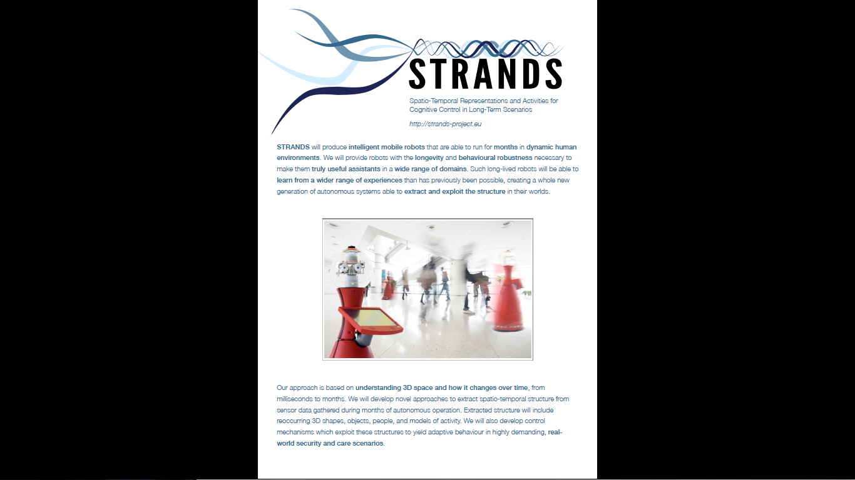

Slide 3
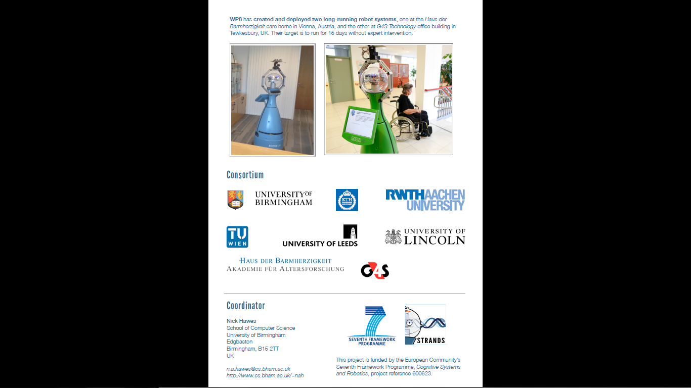

Slide 4
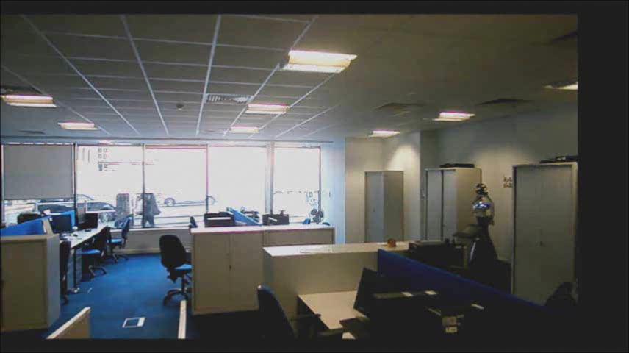
Robots on patrol

Slide 5
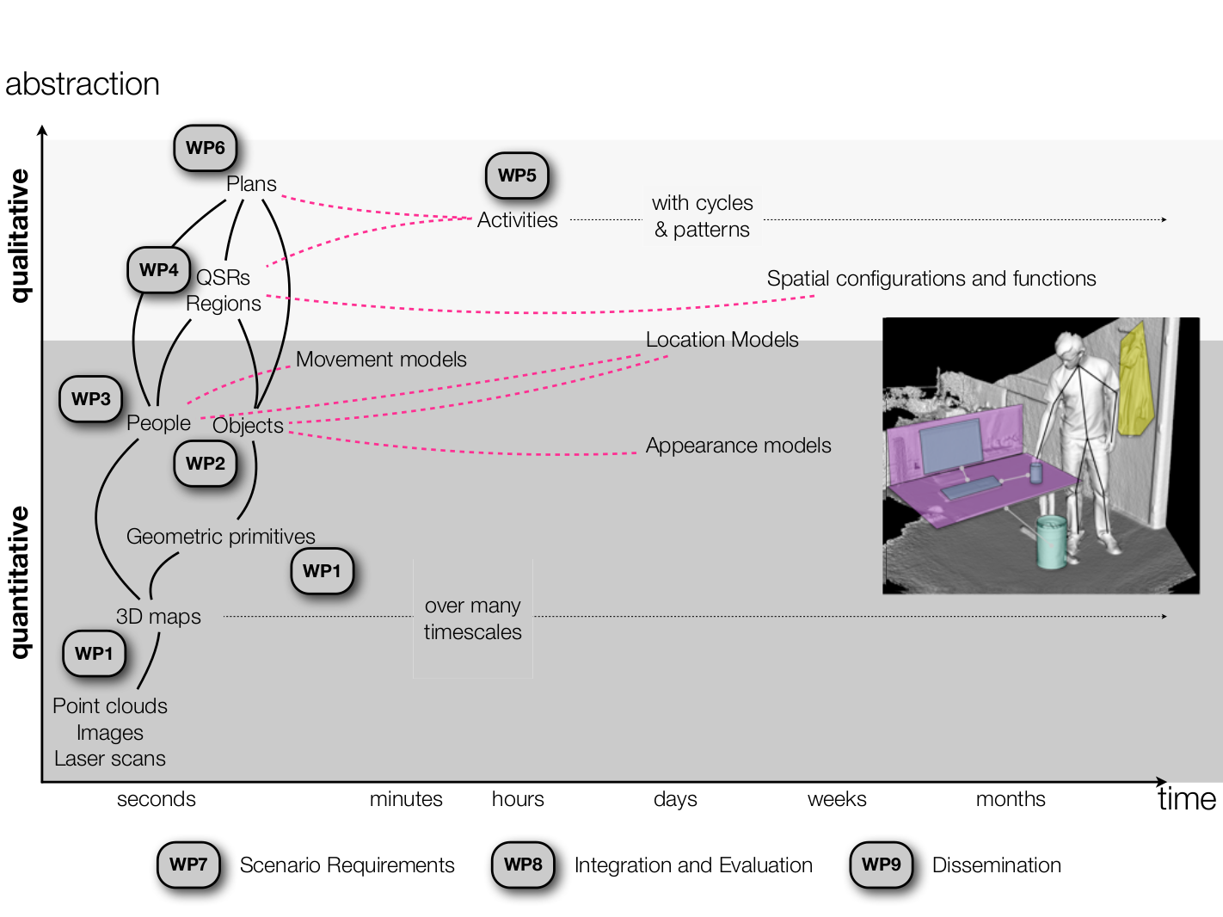
Notes:
(2 out of 6 objectives)
O1: A unified understanding of space over time (WP1, WP4)
O2: Semantic segmentation of space (WP1,WP2, WP3, WP4, WP5)
First level of abstraction towards symbolic representations

Slide 6
Mapping & Localisation in CHANGING Environments – Approach 2: META-ROOMS

Slide 7
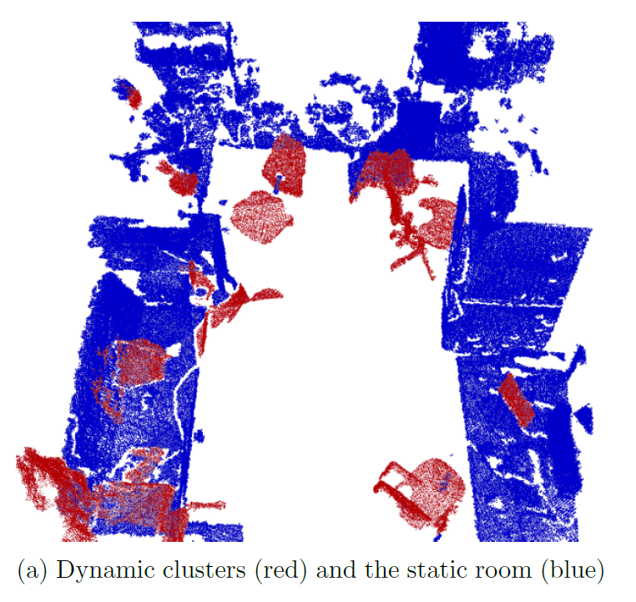
Meta-Rooms
A volumetric-based method for re-creating the static structure of cluttered environments (“meta-rooms”).
Iterative improvement over time from partial observations
Segmenting clusters of dynamic objects
R. Ambrus, N. Bore, J. Folkesson and P. Jensfelt. Meta-rooms: Building and Maintaining Long Term Spatial Models in a Dynamic World. ICRA 2014 Workshop on Visual Place Recognition in Changing Environments

Slide 8
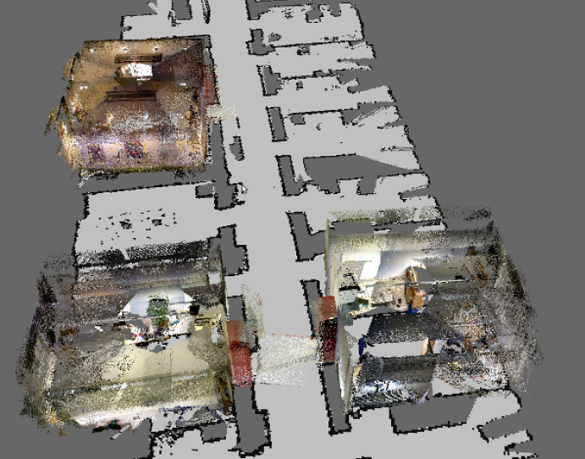
Coloured 3D point cloud data
Down-sampled and filtered to remove noise

Slide 9
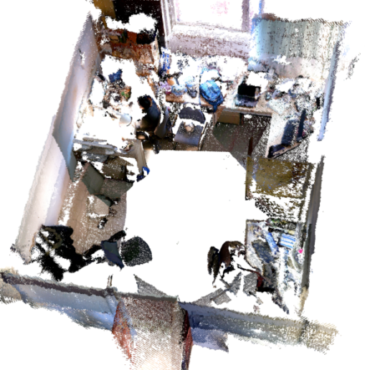
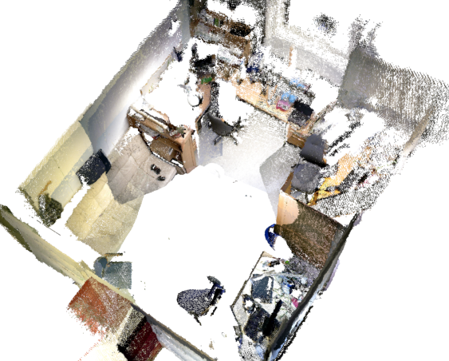
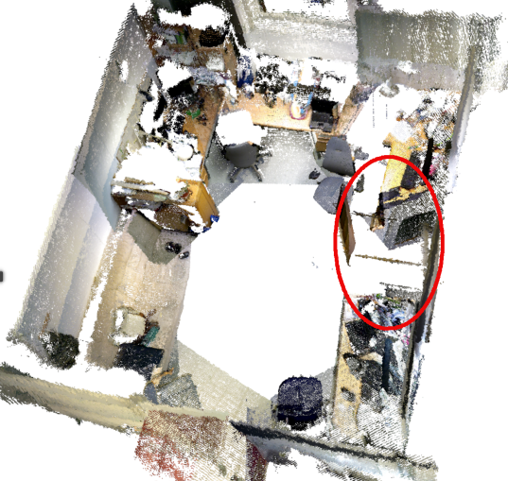
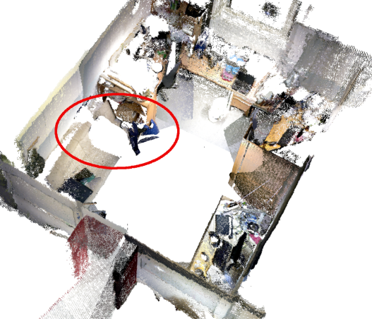
Observations – input data
Pan-tilt sweeps at predefined waypoints
Red ellipses indicate missing sensory data
Filtering, boundary detection
Registration
Scans of the same room from 4 different days

Slide 10
Meta-Room
Definition: the static structure of cluttered office environments
Created through an iterative process where dynamic elements are eliminated from the scene and previously occluded elements are added.
Once a meta-room has been created, dynamic elements can easily be extracted from new observations
Based on point cloud differencing:
P,Q – input point clouds, S – resulting point cloud, d – distance threshold

Slide 11
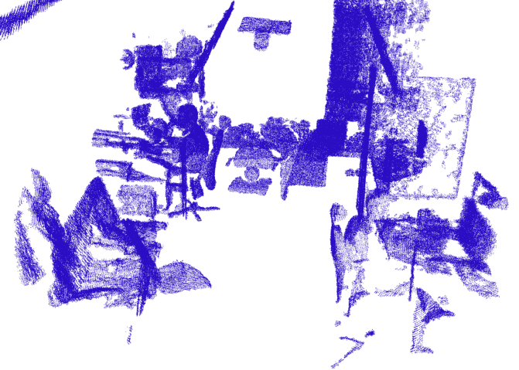
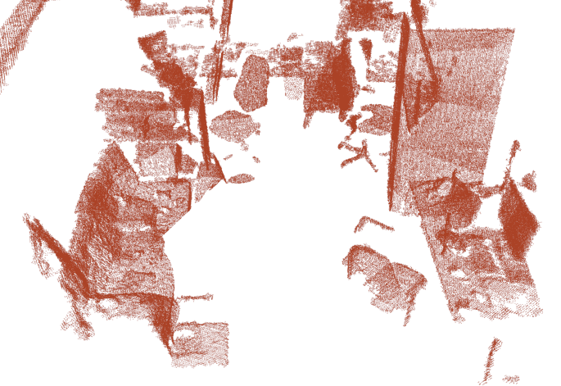
Meta-Room Update
Current meta-room
New observation

Slide 12
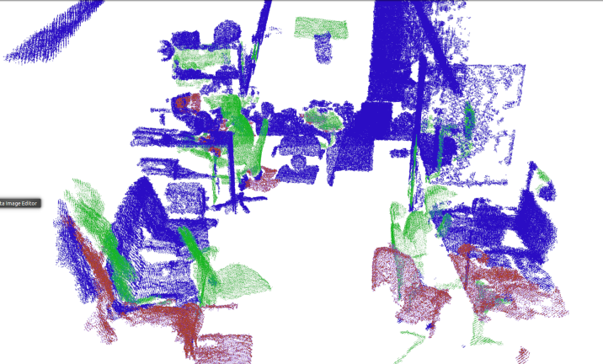
Meta-Room Update
Current meta-room
New observation
Occluded clusters
Green = deleted parts, Red = added parts

Slide 13

Meta-Room Update
Current meta-room
New observation
Occluded clusters
Updated meta-room
Green = deleted parts, Red = added parts

Slide 14
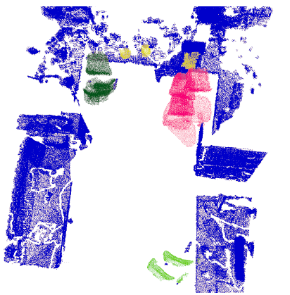
Dynamic clusters

Slide 15
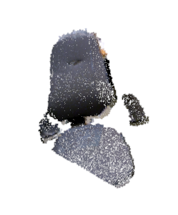
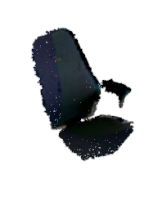


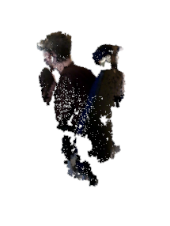
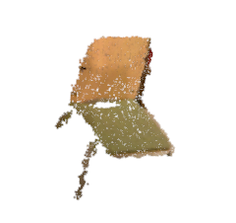
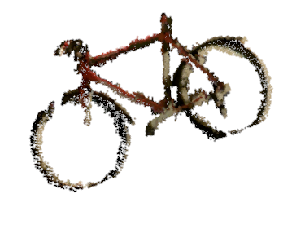
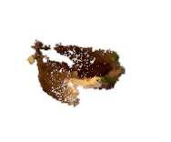
Dynamic clusters
Office chair
Pillow
Lamp
Office chair
PhD student on chair
Bicycle
Kitchen chair
Fruit basket

Slide 16
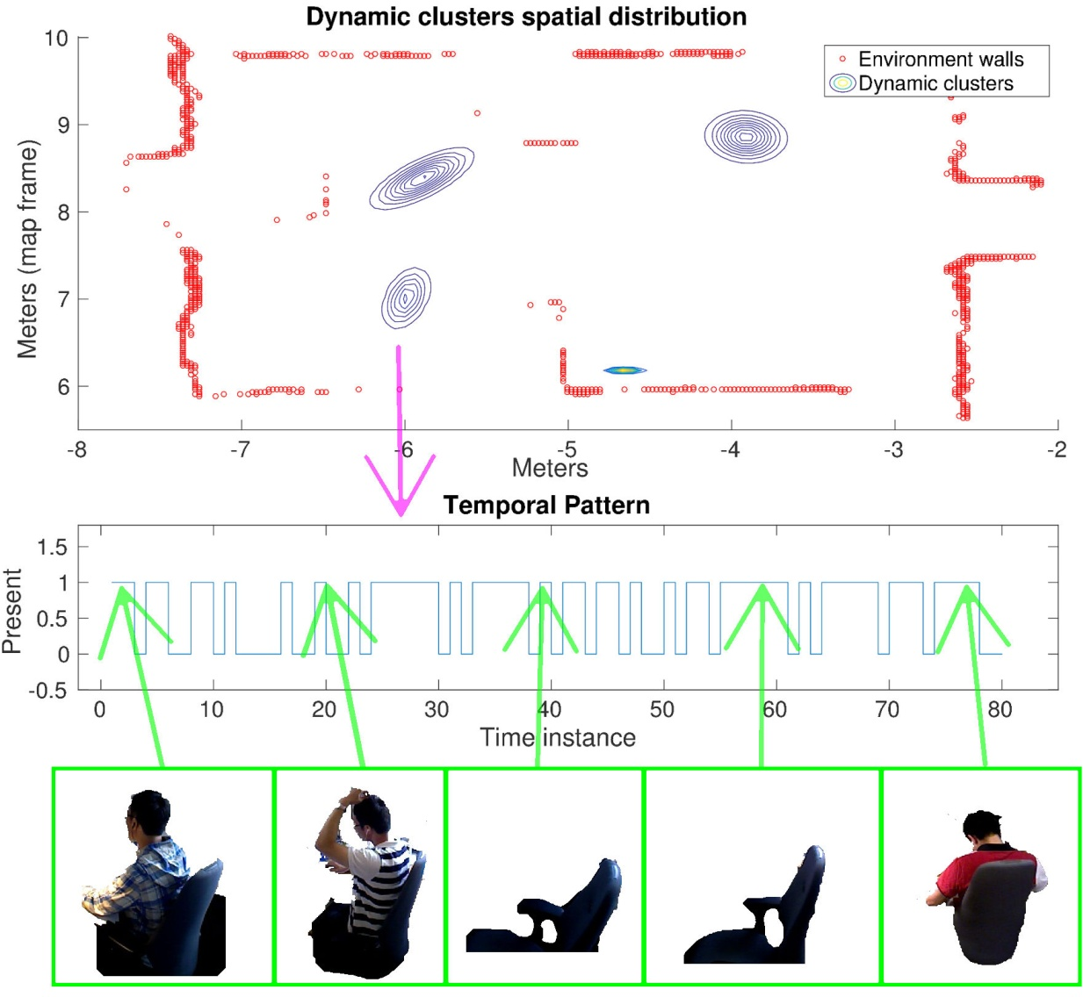
Unsupervised learning of objects
Segment the dynamic elements into distinct clusters and re-identify them across observations.
Use appearance models, spatial distribution, and temporal behaviour
Significant improvement of the object detection rate compared to the original MetaRoom method.
R. Ambrus, J. Ekekrantz, J. Folkesson and P. Jensfelt. Unsupervised learning of spatial-temporal models of objects in a long-term autonomy scenario. Proc. IROS 2015.

Slide 17
Mapping & Localisation in CHANGING Environments – Approach 3: FREQUENCY MAPPING

Slide 18
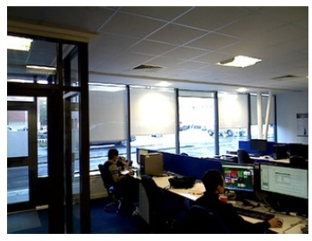
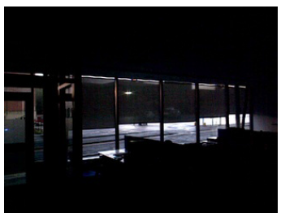
A Frequency-based Approach to Robotic Mapping (FreMEn)
Explicitly models the environment's dynamics based on spectral analysis
Enables prediction of environment state at a particular time of day, based on history of past observations
T. Krajnik, J. P. Fentanes, G. Cielniak, C. Dondrup, and T. Duckett. Spectral Analysis for Long-Term Robotic Mapping. In Proc. ICRA 2014.
Notes:
Amplitudes, phase shifts, frequencies

Slide 19
Objectives
“Total recall”
Security, assistive care, etc.
Compactness
Online reasoning
Prediction
What will happen at time t?
Novelty detection

Slide 20
Temporal domain modelling
Classical world models neglect the temporal domain:
uncertainty of any state s_{i} is modelled by its probability p_{i}
Including temporal aspect means that:
uncertainty of s_{i} (t) is modelled by probability p_{i} (t)
However:
storing all observed s_{i} (t) and p_{i} (t) is not feasible
Basic idea:
in days-to-months scales, s_{i} (t), p_{i} (t) are quasi-periodic
represent p_{i} (t) as superposition of harmonic functions
identify harmonic functions by Fourier transform

Slide 21
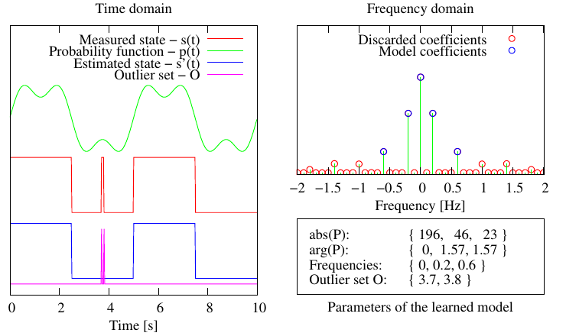
FREquency Map ENhancement
T. Krajnik, J. P. Fentanes, G. Cielniak, C. Dondrup, and T. Duckett. Spectral Analysis for Long-Term Robotic Mapping. In Proc. ICRA 2014.
Notes:
Amplitudes (influence), phase shifts (time offsets), frequencies (periodicities)

Slide 22
Fourier Transform
See video

Slide 23
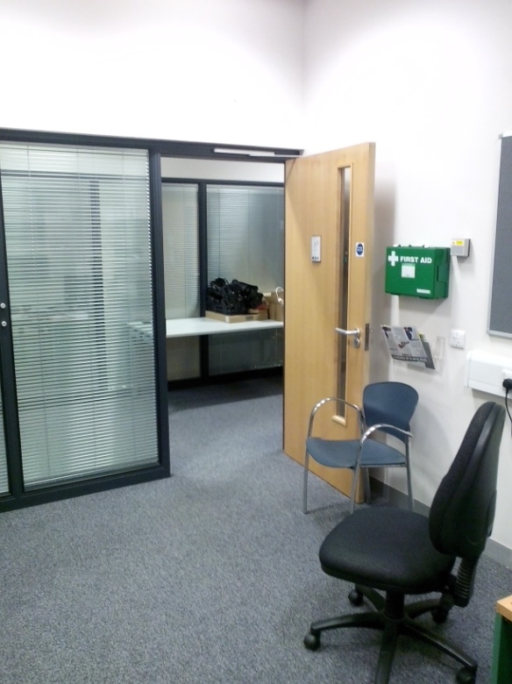
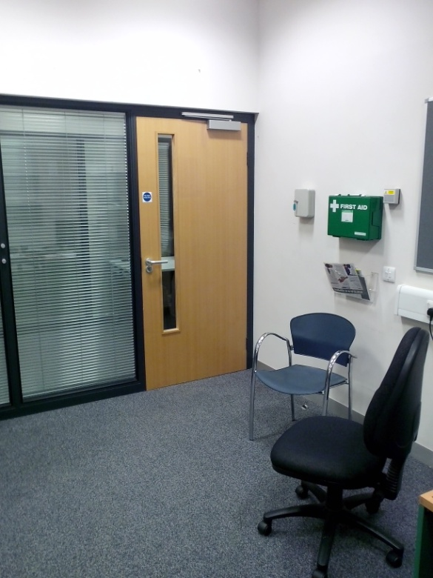
Temporal domain model: example
Continuous observation of an office door (open/closed)
State s(t):
open/closed
Timescale:
one week
Measurements:
30Hz x 7 days
≈ 18 000 000

Slide 24
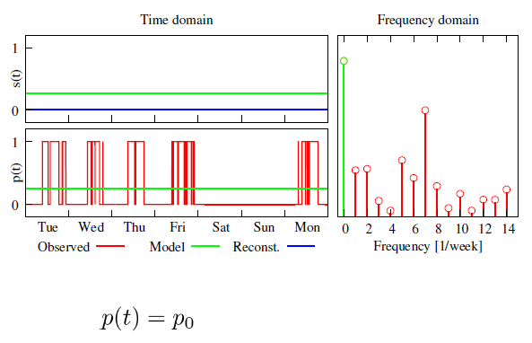
Temporal domain model: example

Slide 25
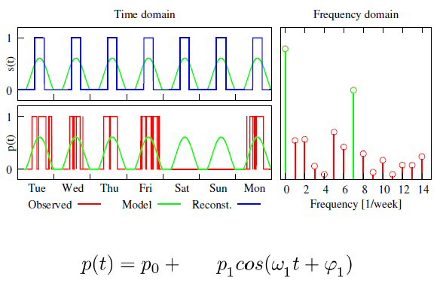
Temporal domain model: example

Slide 26
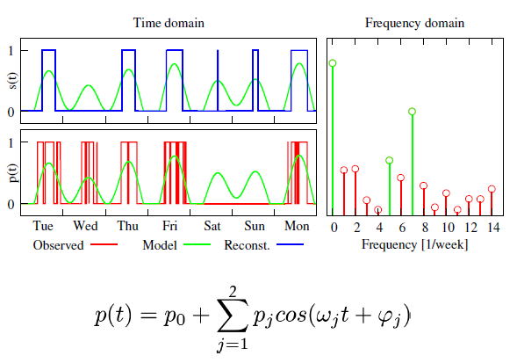
Temporal domain model: example

Slide 27
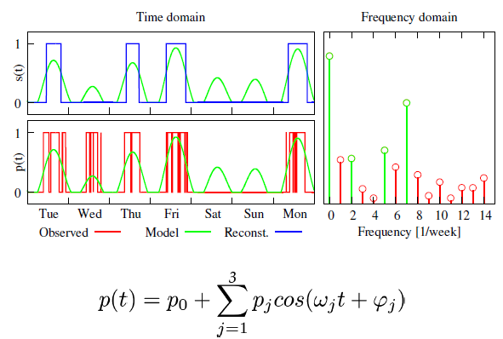
Temporal domain model: example

Slide 28
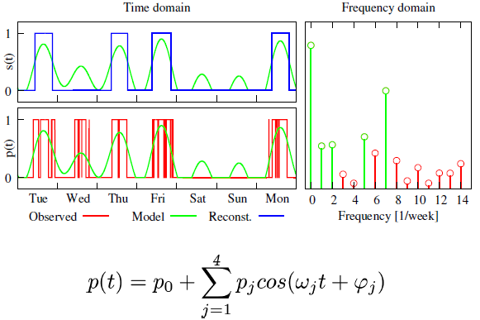
Temporal domain model: example

Slide 29
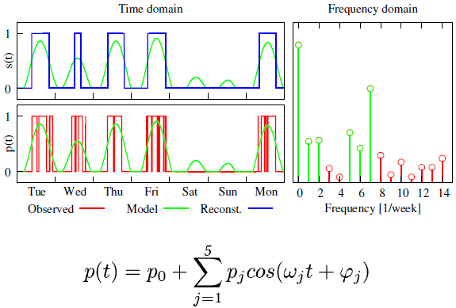
Temporal domain model: example

Slide 30
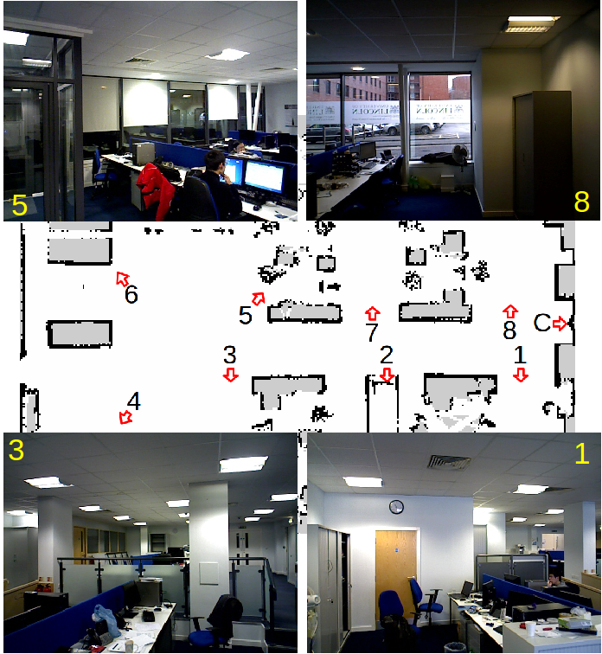
Example 2: Topological Localization
Predict visual appearance of the environment and use the predicted model for topological localization
T. Krajnik, J. P. Fentanes, O. Mozos, T. Duckett, J. Ekekrantz and M. Hanheide. Long–Term Topological Localisation for Service Robots in Dynamic Environments using Spectral Maps. In Proc. IROS 2014.

Slide 31
Example 2: Topological Localization
3D point clouds and RGB images of eight locations recorded every 10 minutes
Training:
Model constructed using one week of data in 2nd week of Nov. 2013
approx. 8000 observations, 35 km travelled
Testing
One day in the next week (Nov. 2013)
Another day in Feb. 2014

Slide 32
Example 2: Topological Localization
Tested two types of place models:
3D occupancy grids
Matched using Hamming distance
Visual descriptors
BRIEF algorithm

Slide 33
Example 2: Topological Localization
See video

Slide 34
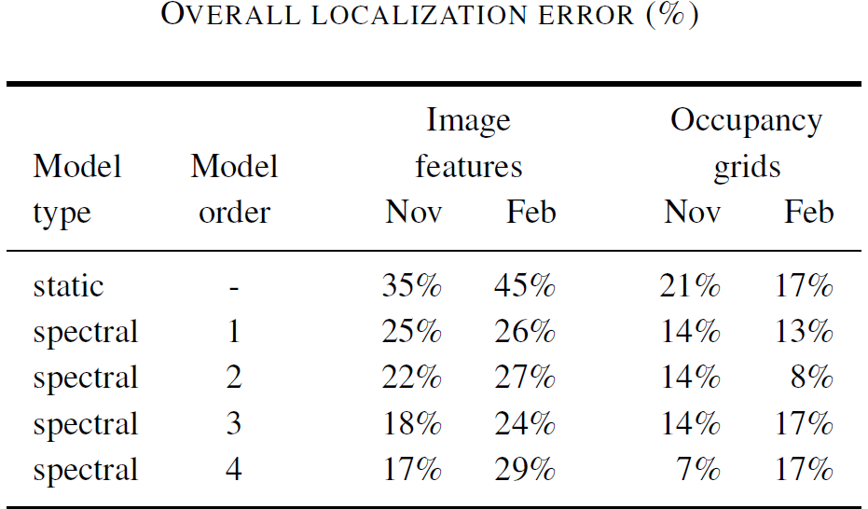
Example 2: Topological Localization
Spectral model learned during Nov 2013 was used
for localization on December 2013 and February 2014

Slide 35
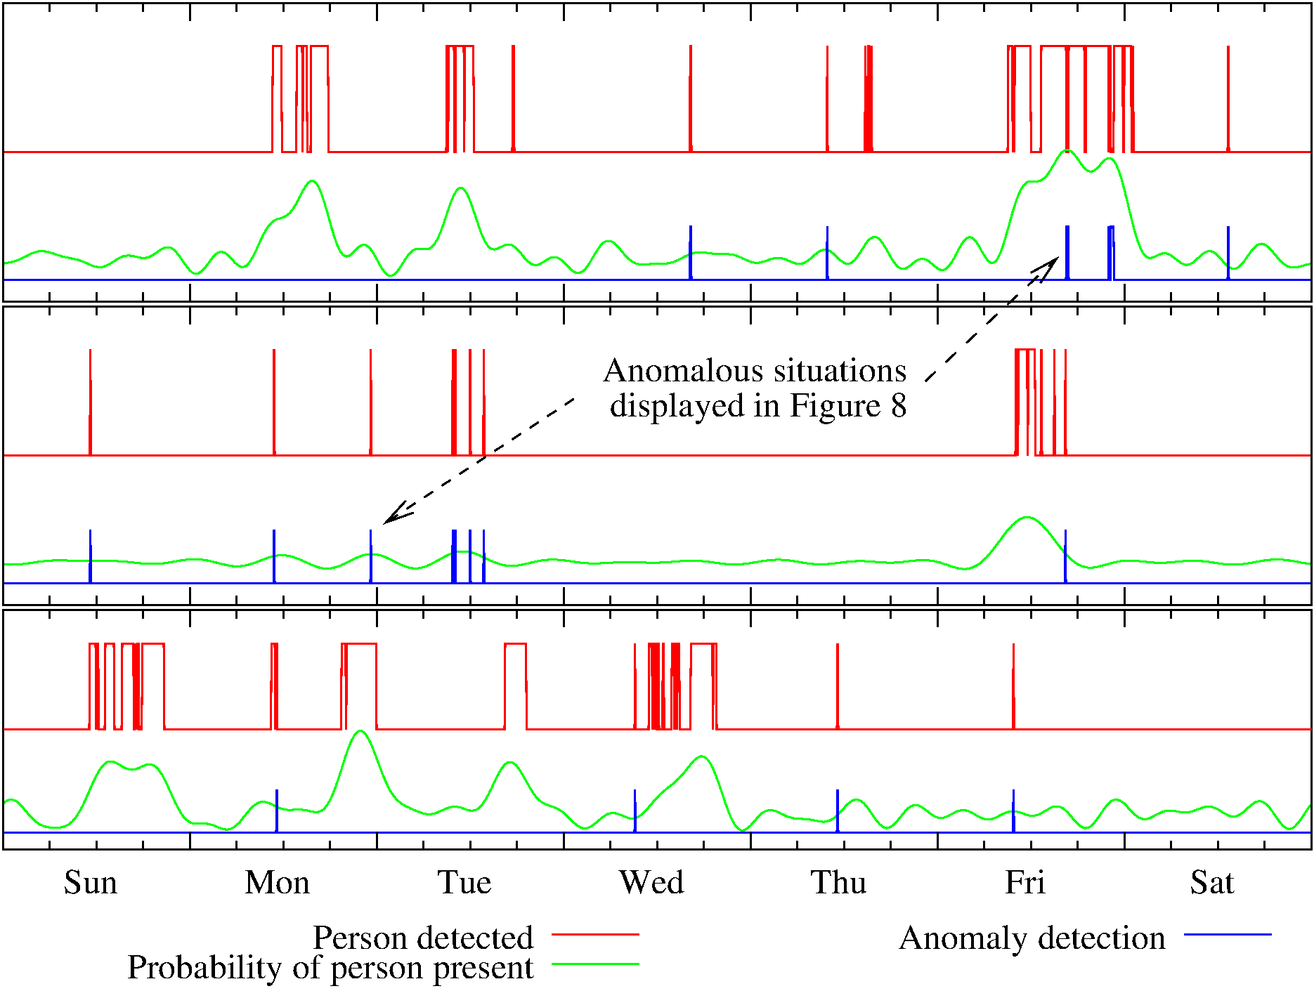
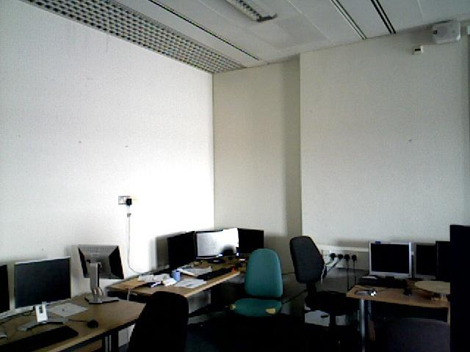
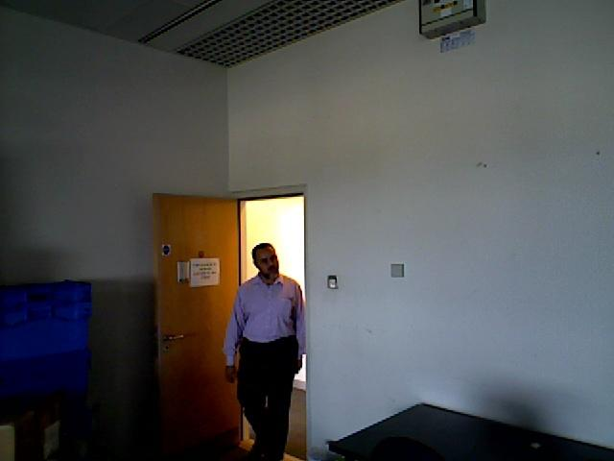
Example 3: Anomaly detection: Person presence
Location-specific model of person presence at three different locations
Anomalies

Slide 36
Example 4: Time-dependent topological maps for motion planning
J. P. Fentanes, B. Lacerda, T. Krajnik, N. Hawes and M. Hanheide. Now or Later? Predicting and Maximising Success of Navigation Actions from Long-Term Experience. In Proc. ICRA 2015.

Slide 37
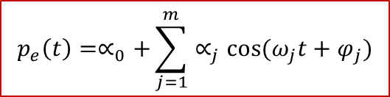
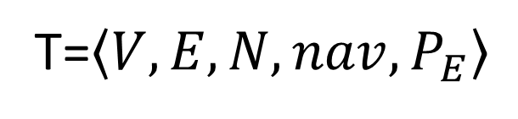
Augmented Topological Map Representation
T=$\left\langle V,E,N,nav,P_{E}\right\rangle$
Set of Locations
Is the set of probabilities of each edge being traversable at time t,
Action Between Locations
Set of Possible Actions
$$p_{e}\left(t\right)=∝_{0}+\sum_{j=1}^{m}{∝_{j}\cos{(ω_{j}t+φ_{j})}}$$
Function that maps an edge
between two locations to an
action

Slide 38
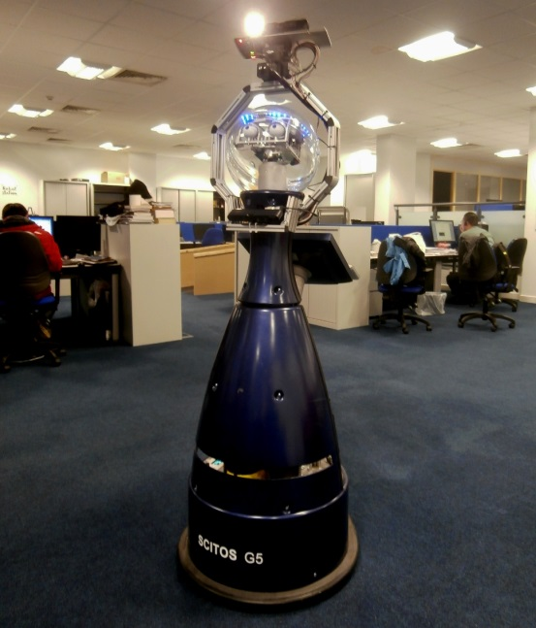
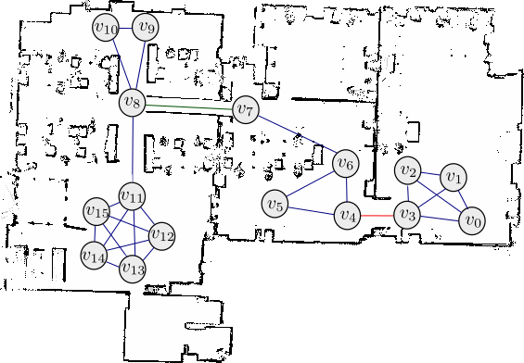
Long-Term Deployment
Experimental Deployment
Total Days | 76
Days of Activity | 35
Nodes In Topological Map | 17
Edges In Topological Map | 62
Door

Slide 39
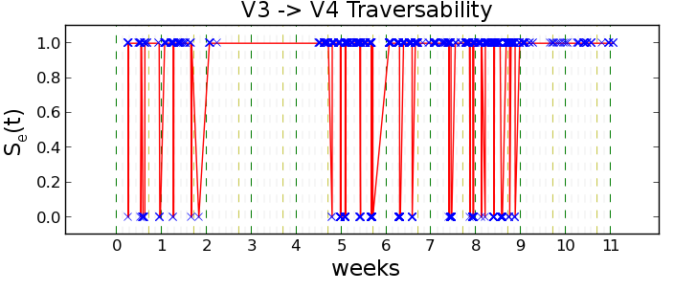
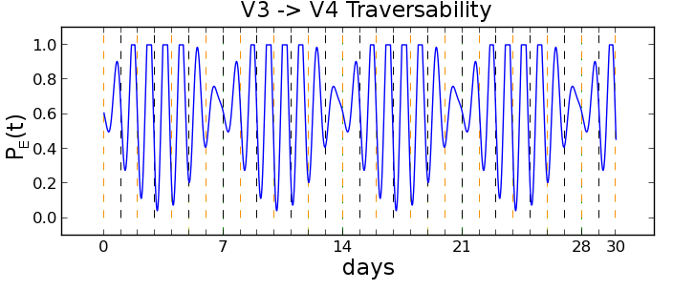
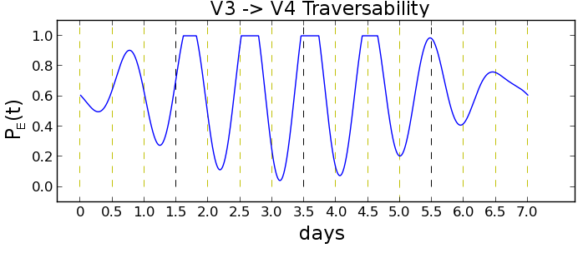
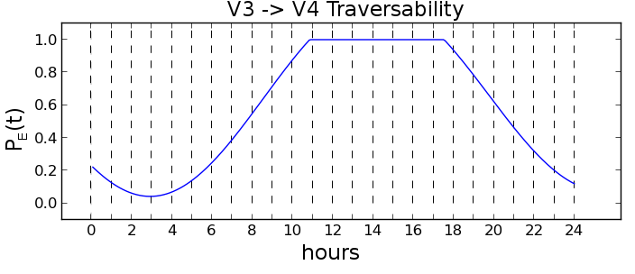
Periodicity and Prediction Analysis
One Month
Signal
One Week
One Day

Slide 40
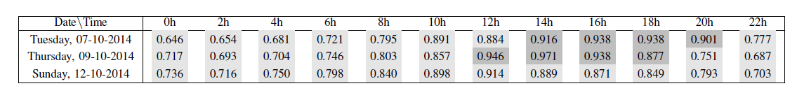
High Level Motion Planning
Maximum Probabilities of fulfilling task (Fv1 V Fv14) at different dates and times of day

Slide 41
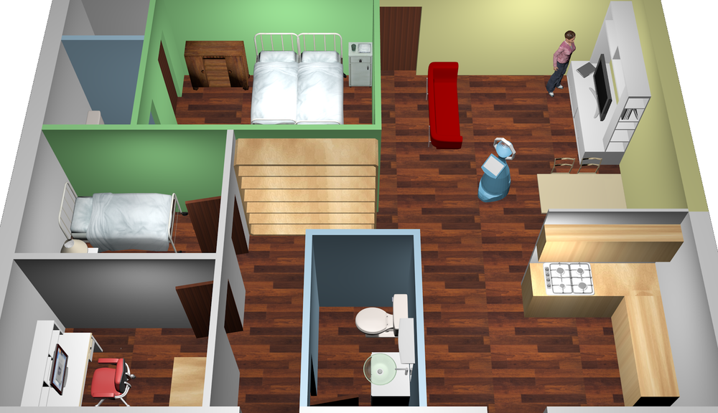
Example 5: Spatio-temporal exploration of dynamic environments
Spatio-temporal exploration is a never-ending (life-long) process
The robot has to determine both where to go and when to go there
Our approach combines
Spatio-temporal entropy
Information-gain-based exploration
The CASAS-Aruba environment
T. Krajnik, J. Santos and T. Duckett. Life-Long Spatio-Temporal Exploration of Dynamic Environments. In Proc. ECMR 2015., Lincoln, UK.

Slide 42
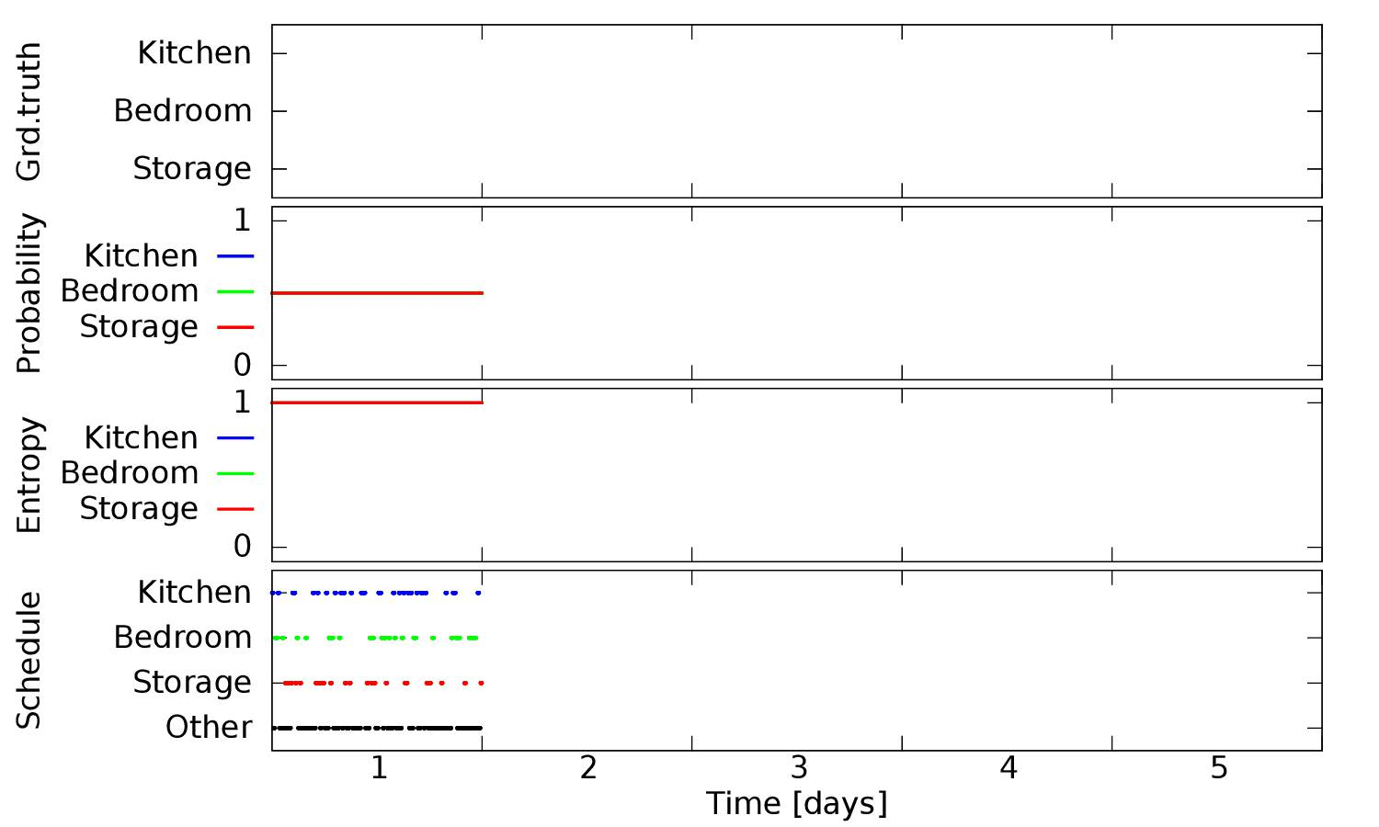
Spatio-temporal exploration

Slide 43
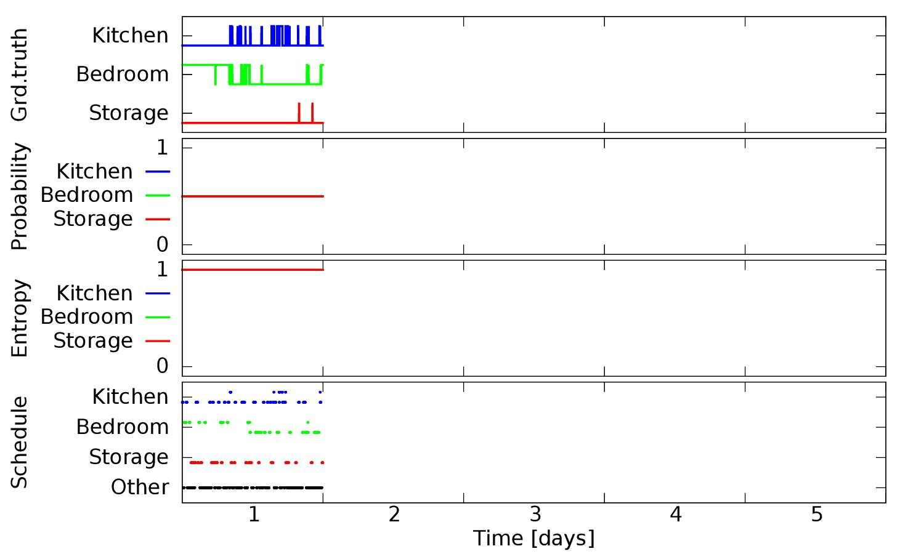
Spatio-temporal exploration

Slide 44
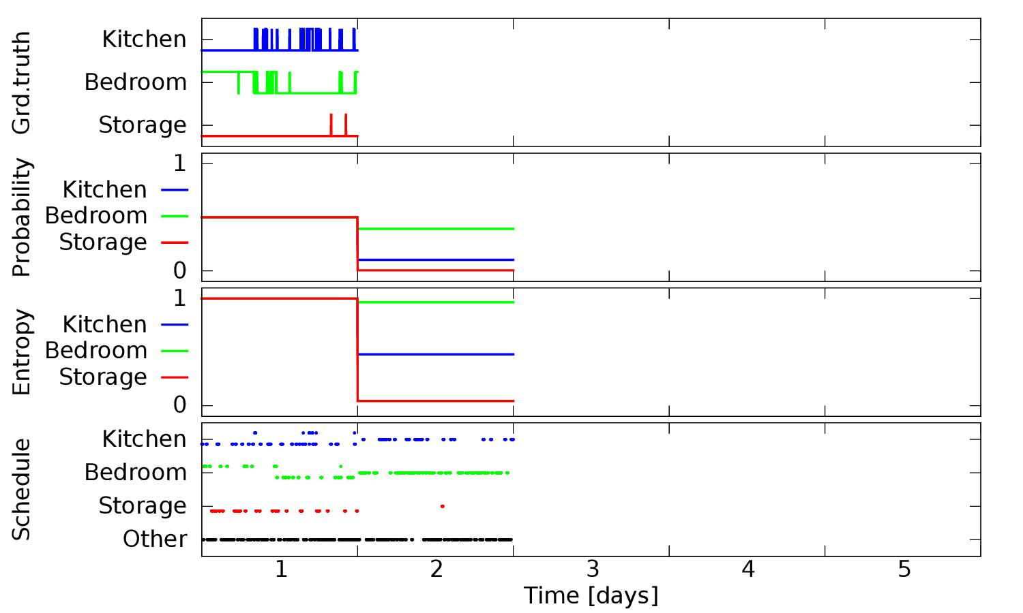
Spatio-temporal exploration

Slide 45

Spatio-temporal exploration

Slide 46

Spatio-temporal exploration

Slide 47

Spatio-temporal exploration

Slide 48

Spatio-temporal exploration

Slide 49

Spatio-temporal exploration

Slide 50

Spatio-temporal exploration

Slide 51

Spatio-temporal exploration

Slide 52

“4D” Spatio-temporal exploration
Information-driven map updates
Spatio-temporal information-driven Next Best View.
FreMEn occupancy grids + spatio-temporal entropy estimates + temporal path planning
(Joao Santos’ PhD topic)

Slide 53

“4D” Spatio-temporal exploration
FreMEn-based occupancy grid of the Lincoln Centre for Autonomous Systems (L-CAS) office. The static cells are in green and cells that exhibit daily periodicity are in red.
T. Krajnik, J. Santos and T. Duckett. Life-Long Spatio-Temporal Exploration of Dynamic Environments. In Proc. ECMR 2015., Lincoln, UK.

Slide 54
Conclusions
World model that takes into account the dynamics of the environment from a long-term perspective.
We represent state changes using periodic functions, identified by means of the Fourier transform.
FREMEN is suitable for different timescales with constant memory requirements.
Can extend any world model with binary states, e.g. gridmaps (Octomap), landmarks and semantic maps
Compression ratios 1:10⁶, prediction accuracy 95%.
Localization failure rate halved even after three months.

Slide 55

Thank you for your attention.
Questions ?

Slide 56
RELATED WORK

Slide 57
Related Work
Hierarchical Object Maps (Anguelov et al. 2002)
SLAM with Detection And Tracking of Moving Objects (Wang and Thorpe, 2002)
partition the static elements from the non-static elements, and consider each set separately.
cannot handle long-term changes

Slide 58
Related Work
Temporary Maps (Meyer-Delius et al., IROS 2010)
model the effect of temporary objects by performing local SLAM
localization with particle filter using these locally static maps

Slide 59

Related Work
Independent Markov Chain Occupancy Grid Maps (Saarinen at al., IROS 2012)
independent Markov chains (iMac) stored with every cell on the grid

Slide 60
Related Work
Rao-Blackwellized Particle Filter with Hidden Markov Model (Tipaldi et al., 2013)
Dual –timescale NDT-MCL (Valencia et al., 2014)
Short-term map
Static map
Episodic Non-Markov Localization (Biswas & Veloso, 2014)
Reasoning About Short-Term and Long-Term Features

